Slide 1
Gizmondo Studios
Driving the Gizmondo Hardware

Slide 2
Who are these People!
Paul Hughes (Paulie)
  CTO Gizmondo Studios
Paul Hodgson (Hodge)
  Lead Engineer TnT Group
Richard Crockford (Rich)
  Software Engineer TnT Group

Slide 3
Today’s Agenda
Quick overview of “What’s in the Box”
Driving the GPU
  SC10 Tips and Tricks
  SC10 GPU Internals
Driving the CPU
  ARM in a nutshell
  Squeezing CPU performance
  Programming for Performance
WinCE
  What’ll you need.
  Working with the Gizmondo Hardware
  Windows CE – Hints and Tips
gzSDK
  What is it?
  What do you want it to be?
Recommended Reading
Q & A

Slide 4
60 Seconds on “What’s in the Box?”
400Mhz Samsung S3C2440 ARM9 CPU
72Mhz NVIDIA GoForce 4500 (SC-10) 3D GPU
2.8” Backlit QVGA TFT @ 320x240x16 bpp
GPS Receiver
Tri Band GSM and GPRS (Class 10, Type B)
Bluetooth wireless networking
Rear Mounted CMOS VGA Camera
64MB SDRAM
64MB Flash Disk
Windows CE 4.2 Operating System
Open GL-ES 1.0 (with extensions)

Slide 5
60 Seconds on “What else is in the Box!”
Secure Digital Card Slot
Mini USB Desktop Connectivity
16 bit, 48kHz Stereo PCM Audio plus MIDI synthesizer
Inbuilt Vibrator (insert your own joke here!)
All 15 inputs are digital;
  Four way Joypad,
  Four “action buttons”
  Two Shoulder Buttons
  Five “Piano Keys”
3.6V Lithium Ion Battery Pack

Slide 6
Hitting the Silicon
Driving the GPU

Slide 7
SC-10 Tips and Tricks #1
After double buffers and Z buffer are allocated from the resident 1280K you have 830K left for resident textures.
The GPU only handles the positional transform on chip.
Lighting calculations are better performed at application side and not through the GL driver.
Submit all vertices in 16:16 fixed point NOT float.
Use multi texturing over multi pass rendering as the 565 dither is done post rasterization.
1K Texture cache works in SOURCE data format, so the more compact your texture format the more you get in the cache!
Sort and dispatch on state.

Slide 8
SC-10 Tips and Tricks #2
CPU / GPU parallelism can be achieved with carefully timed operations between FIFO feeds.
Z test takes just as long to pass as to fail, but killed pixels are not loaded by the texture cache. If possible draw in front to back order for faster throughput.
GL Depth MUST be set at 0,1! Otherwise the Z Guard is disabled and the hardware has to clip everything (at ~60 clocks per vertex).
Limit to a single MIP wherever possible, as this saves memory (the driver allocates memory for the entire chain when MIP Levels >1), it also saves on driver per vertex LOD calculations at ~60 clocks per vertex).
The ALU “shares” certain operations in its slots, so you might as well use the shared function as the time is burned no matter what.

Slide 9
SC-10 Tips and Tricks #3
Use DXT1 textures when you don’t need alpha
Strip those triangles like a demon!
Did I mentioned stripping those triangles?
  Caveat – strip for vertex reuse rather than strip length
    Verts are internally marked as transformed, so reuse saves transform time
Use the smallest vertex format necessary to get the best use of the FIFO.
Remember it’s a small screen - use as small a texture resolution as possible as Texture memory is scarce.
Remember that Point / Line anti-aliasing and Fogging add to your vertex and texture pass overhead when calculating how much to feed the FIFO with.
Only draw what you can see - Cull as much as possible before you get to the driver level!

Slide 10
SC-10 Tips and Tricks #4
Texture swizzling is done at TexImage time; avoid partial texture updates as they are currently VERY slow!
Max Texture size is 256 x 256.
GPU natively supports DXT1a/c, 8 / 4 bit palletised and 16 bit textures (1555, 565, 4444) amongst others.
The GPU only has enough on chip RAM for one 8 bit palette (or 16, 16 entry palettes) bound at any one time.
Any 2D operations (clear, BLit, flip, texture download) flush the 3D pipe.
  Note the flip isn’t really a flip! Because the screen is really portrait the image is blitted and rotated by 90 degrees upon flip.
There’s no support in hardware for partial video memory to video memory copies. This is all done very slowly in software (frame->memory->twiddle->frame)

Slide 11
Hitting the Silicon
GPU Internals

Slide 12
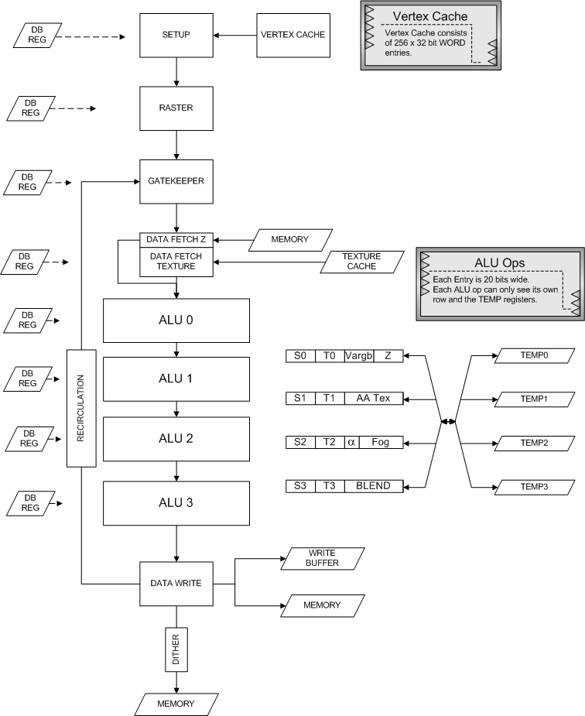

Slide 13
ALU Functions
8 instruction slots
Performs a*b (op) c*d on one parameter per row per unit
  operations have 10-bit precision (S1.8)
  total R,G,B,A precision is 40 bits
  Can complement (1-x on a and c) or negate (-x on b and d) operands
  Can clamp result to 0..1 range
Operates on any of the 20-bit ‘R’ variables from pixel packet
Can also use
  2 20-bit constants per unit (read-only)
  2 20-bit temporary values per unit
4 ALUs operate as “pipelined in serial”

Slide 14
ALU Operations #1
MAD: r = a * b + c * d
MBA: r = a * b & c * d
MBO: r = a * b | c * d
MBX: r = a * b ^ c * d
MUL: r(lo) = a * b
r(hi) = c * d
MIN: r = min( a * b, c * d )
MAX: r = max( a * b, c * d )

Slide 15
ALU Operations #2
SNE: r = (a * b) != (c * d) ? 1.00 : 0.00
SEQ: r = (a * b) == (c * d) ? 1.00 : 0.00
SLT: r = (a * b) < (c * d) ? 1.00 : 0.00
SLE: r = (a * b) <= (c * d) ? 1.00 : 0.00
KNE: kill if (a * b) != (c * d)
KEQ: kill if (a * b) == (c * d)
KLT: kill if (a * b) < (c * d)
KLE: kill if (a * b) <= (c * d)

Slide 16
Cycle Stealers
The following burn an extra cycle per pixel…
Alpha Test and Fog (combined)
Alpha Blend and Colour Masking (combined)
Each additional Texture Stage (x2 clocks for Tri Linear)
Anti Aliased Points and Lines

Slide 17
Numbers, Numbers, Numbers!
With a vertex format of simple position and UV you can expect between 3000 and 4,500 triangles transformed and drawn every 60th of a second.
Expect a fill rate of 0.072 Giga Pixels
  This is the equivalent of 16x overdraw
  However, with effects enabled 4x overdraw is more realistic
SC10 has SIX texture surfaces, however…
  Four units can be used for combining textures
  One unit is for the fog table (will get access to the table in the future)
  One unit is for the anti-alias table

Slide 18
Hitting the Silicon
Driving the CPU

Slide 19
ARM in a Nutshell
Vanilla ARMv4t RISC Processor (with Thumb), no floating point operations and no integer divide instructions.
16 Registers r0..r15, of which 14 are available as general purpose registers (r0..r12 and r14). r13 is the stack, and r15 is the program counter.
The Samsung ARM9 has 32K of on chip cache shared in two blocks of 16K for I-Cache and D-Cache.
Both caches are 64-way set associative and have 32 byte cache lines.
ARM is cool – most ARM mode instructions are conditional, so you do get one hell of a bang for your buck.

Slide 20
Squeezing CPU Performance
Cache is King!
  Cache misses are HUGELY expensive @ 91 cycles for a miss!
Learn how the ARM works, don’t rely on the compilers.
  Even naive assembler can outperform the compiler!
  Optimal assembler will totally cream the compiler!
Check your compiler output regularly.
  eVC’s ARM backend puts out some odd, suboptimal code
Avoid (emulated) floating point operations like the plague!
  When working in a known domain, use 16.16 fixed point.
  For operations on broader domains (such as Physics) use the logarithmic fpu from the gzSDK*

Slide 21
Hitting the Silicon
Programming for Performance

Slide 22
Defensive Programming #1
For local variables don’t use char or short (unless you want wrapping)
  Instead use integer types to avoid casts, and exploiting ARM’s 32 bit processing.
Unsigned types are faster when using (power 2) division
Avoid passing char and short as function arguments, always use a 32 bit type otherwise the compiler has to generate extra code.
Use loops that count down to zero, so the compiler doesn’t need to allocate an extra register for the termination value (and the zero compare is free)
Use unsigned loop counters by default and the continuation “i != 0” rather than “i > 0” this ensure loop overhead is only two instructions.
Unroll important loops to reduce loop overhead.
  Caveat too much unrolling will bloat the code and hurt the cache
If you limit the number of local variables within your inner loops to < 12 the compiler will have the opportunity to cache these in the registers
Avoid large structures, instead use a hierarchy of smaller structures
Avoid bit fields – use #define or enum the mask operations

Slide 23
Defensive Programming #2
Avoid using unaligned data if at all possible.
Use type “char *” for data that can be at any byte alignment. Access this data by reading bytes and combining with logical operations
  This ensures the output code won’t depend on alignment and endianness.
  In general don’t use unaligned data!
Don’t rely on the compiler to optimise out repeated memory accesses
  Pointer aliasing often prevents the compiler from optimising them.
  Avoid aliasing by creating new local variables to hold the expression
Try to limit function calls to four arguments
  The compiler should be able to pass the arguments faster via registers.
Avoid divisions! Multiply by reciprocals wherever possible.

Slide 24
Defensive Programming #3
Expand out your conditionals;
if ( bob == true )
{
alice = false;
}
else
{
alice = true;
}
Generates more optimal code than;
  alice = ( bob == true ) ? false : true;

Slide 25
Defensive Programming #4
Use C++ with care!
  Remember the eVC compiler is based on Visual Studio 4.0
    CPP support isn’t bleeding edge!
  Compilers have a tough time creating optimal RISC code for CPP paradigms.
    This may explain why the official ARM C/CPP Compiler is $6000 per seat!
  Virtual functions and all vtable based operations kill the cache
  Limited template support
  No exception support
  Disassemble frequently to see what the compiler is doing with your classes!
  Avoid deep class hierarchies

Slide 26
WinCE 4.2
Adventures with the OS

Slide 27
What you’ll Need
Microsoft’s Embedded Visual C 4.0 (free download!)
  Patched up to service pack 4
The Gizmondo Win CE GTERM platform SDK
Gizmondo USB device driver
  Guard this with your life! It gives you complete access to the Flash disk. The retail driver will not!
Microsoft Active Sync 3.7.1
Microsoft Windows CE Power Toys (free download!)
NVIDIA Open GL-ES 1.0 SDK
The Gizmondo gzSDK*

Slide 28
Working with the Gizmondo Hardware #1
With Active Sync installed you can explore the flash disk and SD cards just like a normal hard drive.
Visual Studio deals with copying executables and DLLs to the unit.
Full remote debugging and profiling is available via the mini USB.
  Caveat when Profiling there is latency getting the graphs across the USB connection
Using the Windows CE Power Toys, you can remotely execute apps on the Gizmondo, and batch send files across the USB to the unit.

Slide 29
Working with the Gizmondo Hardware #2
The standard Windows CE APIs deal with the majority of the interfacing to the hardware.
The Windows Message Pump deals with all the digital inputs via the VK_KEY mechanism
Bluetooth and GPRS are handled via the Windows Sockets APIs
Basic Audio is handled by the WAVEOUT device.
2D functionality can be handled via the standard GDI functions, or with DirectDraw to directly grab the frame buffer (like GAPI).

Slide 30
Working with Gizmondo Hardware #3
Video and Digital Stream Playback can be accomplished via the DirectShow filter graph mechanisms
  WIN-CE has inbuilt support for WMV9, AVI, MPEG, MP3 and WMA decoding
External “events” such as SD card insertion and incoming events such as SMS are signaled to the application via custom Windows messages and read via the normal Message Pump.
GPS and Camera functionality is handled in the gzSDK
All 3D work is handled via the Open GL-ES SDK

Slide 31
Windows CE – Hints and Tips #1
The IEEE Floating point emulations is S-L-O-W
  If you require precision use the gzSDK’s logarithmic FPU
When timing your code with QueryPerformanceCounter() bear in mind there is a 2.36Ms latency so always adjust your timings by this value.
To help balance performance across the background processes put a Sleep(0) at the end of your main loop to yield the application.
MP3 and WMA decoding via the OS is quite latent, and not really conducive to running in your main game loops.
  We will address solutions to this later in the gzSDK slides.

Slide 32
Windows CE – Hints and Tips #2
All file manipulation is via PIO – so don’t expect to be doing much during loads!
  In order to be TRC compliant load your data in sequential chunks wherever possible so you have time to update the screen occasionally (showing that the app hasn’t hung)
Remember that under Windows CE any one process can only directly access 32MB of data.
Accelerated 3D and direct Frame Buffer accesses are mutually exclusive.

Slide 33
gzSDK
Defining the Gizmondo SDK

Slide 34
What is It?
We’d like your feedback on what you would like. Our current thinking is…
Source Code (lots of), Libraries and Documentation to make development easier.
Anything above and beyond what Windows CE gives you “in the box”
  GPS code, camera code
  Heavily optimised audio mixers, high level audio APIs
  Heavily optimised fixed and floating point maths APIs
  Source Code frameworks for all common features
    Networking, GPS, Video Playback, Audio streaming, Rendering examples, Windows CE examples.

Slide 35
What do you want it to be?
What have we missed?
Having experienced other platforms with their SDKs (and support), what would you like to see in here?
We want to work together to create the SDKs, rather than prescribe what the developers should get.
Feedback to us via the Gizmondo Developer Forums!

Slide 36
Recommended Reading
Must Have Books

Slide 37
Time to visit Amazon!
Open GL ES 1.0 Reference Manual
  Claude Knaus – Available from Silicon Graphics
Open GL ES 1.0 Native Platform Graphics Interface
  Jon Leech – Available from Silicon Graphics
ARM System Developers Guide
  Andrew N. Sloss – ISBN 1558608745
ARM Architecture Reference Manual
  David Jagger – ISBN 0201737191
Programming Windows CE .NET
  Douglas Boling – ISBN 0735618844
Windows Sockets Network Programming
  Bob Quinn – ISBN 0201633728

Slide 38
Q & A
Any Questions?

